Slide 1
Thesis Proposal Defence
Brain-Computer Interface Applications with Hardware Specific Optimizations
Aleksander Berezowski

Slide 2
Contents
Research Question
Literature Review
Methodology
Preliminary Findings
Proposed Chapter Headings
Next Steps
Q&A

Slide 3
Research Question
How does input size, hidden state size, word size, and the usage of shift-and-add multiplication affect resource usage, inference time, power consumption, and accuracy of brain-computer interface gated recurrent unit machine learning models deployed on field-programmable gate arrays compared to current hardware and software implementations?

Slide 4
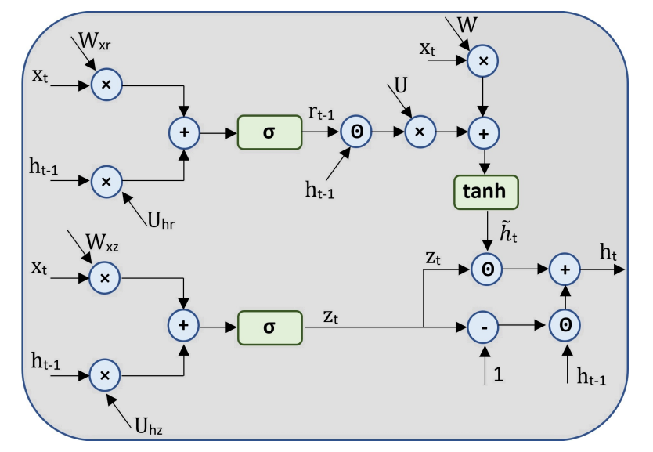
Literature Review: Main Finding 1
Lack of GRU Hardware Implementations
Hardware implementations of GRUs are scarce, with only two documented implementations
Zaghloul et al. [1] first implemented an FPGA-based GRU, demonstrating equivalent performance to LSTMs across multiple time-series datasets
Rizwan et al. [2] reimplemented GRUs with a focus on detecting breast cancer (multivariate classification)
No prior work has explored GRU hardware optimization or hardware GRUs applied to BCI
Limited implementations due to GRUs being new and less used compared to LSTMs [3]
1. Z. S. Zaghloul and N. Elsayed, "The FPGA Hardware Implementation of the Gated Recurrent Unit Architecture," SoutheastCon 2021, Atlanta, GA, USA, 2021, pp. 1-5, doi: 10.1109/SoutheastCon45413.2021.9401819.
2. K. S. Mohammed Rizwan, S. Nikhil Gowda, S. Yashwanth and K. Anuros Thomas, "Custom Hardware Architecture for FPGA-Based Gated Recurrent Unit," 2025 IEEE 14th International Conference on Communications, Circuits and Systems (ICCCAS), Wuhan, China, 2025, pp. 81-86, doi: 10.1109/ICCCAS65806.2025.11102499.
3. J. Chung, C. Gulcehre, K. Cho, and Y. Bengio, “Empirical evaluation of gated recurrent neural networks on sequence modeling,” arXiv preprint arXiv:1412.3555, 2014

Slide 5
Literature Review: Main Finding 2
Potential Hardware Optimizations
Optimization | Summary
Shift-And-Add Multiplication | Substitution of conventional multipliers with lower-complexity shift and addition/subtraction operations
Bit Serial Structures | Transformation of parallel arithmetic operations executed in single clock cycles into serial arithmetic operations distributed across multiple clock cycles
Distributed Arithmetic | Replacement of runtime multiplication operations with precomputed partial sum lookup mechanisms
Mixed Precision | Utilization of variable bit-width numerical representations to optimize resource allocation
Alternative Implementation of Sigmoid and Hyperbolic Tangent Functions | Substitution of piecewise linear approximation (PLA) implementations of sigmoid and hyperbolic tangent functions with lookup table (LUT) architectures

Slide 6
Methodology: Experimental Design
The experimental system comprises several interconnected Python modules and a TCL script that automate the entire design, implementation, and analysis pipeline:
Python scripts (generate_gru_sv.py, generate_top_level_sv.py, generate_gru_tb_sv.py) automatically generate SystemVerilog code for the GRU module, top-level wrapper, and testbench based on specified parameters.
A TCL script (run_vivado.tcl) orchestrates the Xilinx Vivado tool to perform simulation, synthesis, optimization, placement, and routing while generating detailed reports.
Python scripts (extract_metrics.py, float_to_fixed_point.py) parse Vivado-generated reports and simulation outputs to extract hardware metrics and calculate accuracy measurements.
The main orchestration script (main.py) coordinates all phases, collects results, calculates Mean Absolute Error (MAE) metrics, and compiles data into a structured format for analysis.

Slide 7
Methodology: Trial Execution Flow
Each experimental trial follows a structured sequence to ensure consistency and data integrity:
Environment Initialization: The system clears previous results and initializes a tracking file to monitor progress through the large design space.
Parameter Configuration: For each combination of INT_WIDTH, FRAC_WIDTH, d, and h, the system sets these values as constants in the code generation scripts.
RTL Generation: Generate all the SystemVerilog script needed.
Vivado Execution: The TCL script (run_vivado.tcl) performs the following operations: Creates a Vivado project, adds all generated SystemVerilog files, applies timing constraints, runs simulation, executes synthesis, performs placement and routing, generates detailed reports on utilization, timing, and power consumption.
Data Capture:
  extract_metrics.py parses multiple report formats using regular expressions to extract hardware metrics (LUTs, registers, BRAMs, DSPs, WNS, power consumption).
  Simulation outputs are written to text files containing fixed-point binary representations of GRU predictions.
Accuracy Calculation: For each group sharing the same d, h, a ground truth is calculated using floating point numbers. MAE is computed between all other configurations and this reference using calculate_mae_metrics().

Slide 8
Preliminary Findings
Searched the following reduced action space:
  INT_WIDTH: 6
  FRAC_WIDTH: 4, 9, 14
  d: 4, 8, 16
  h: 4, 6, 8
Simulations and implementations took about 1 day to complete
To run the entire action space, will run on a desktop better suited for Vivado
  CPU with a better single core performance and higher clock rate
  Larger amount of and higher frequency RAM
  Linux system instead of Windows

Slide 9
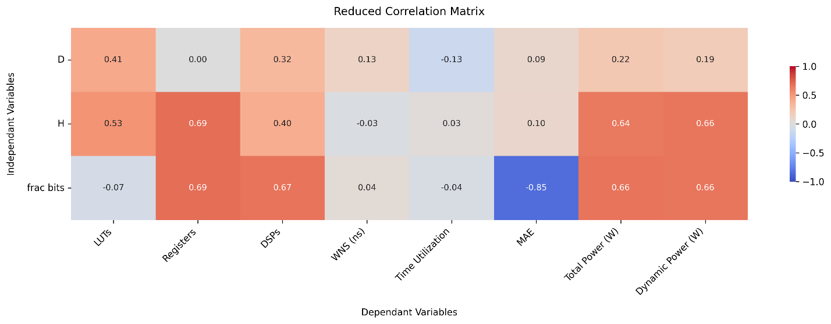
Preliminary Findings

Slide 10
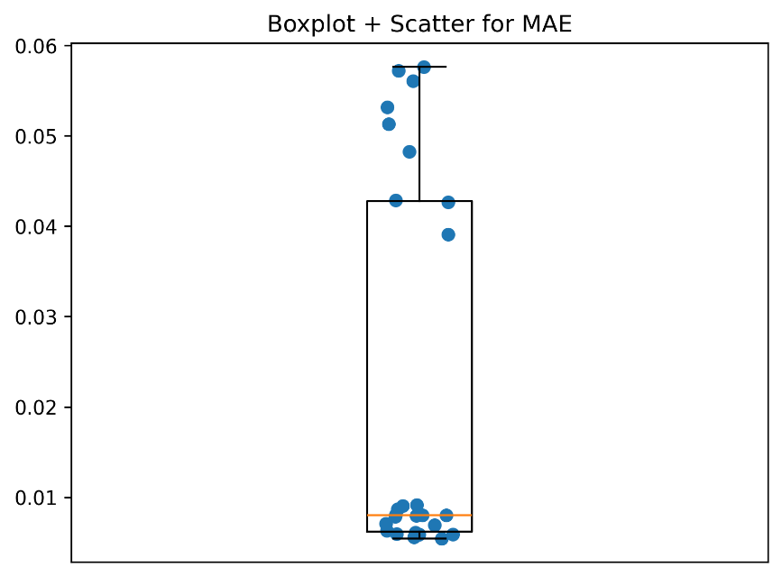
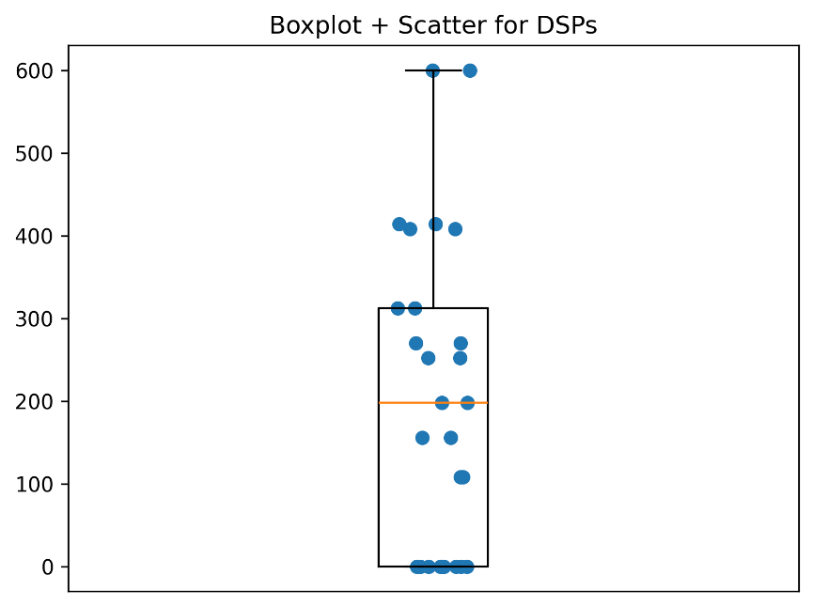
Preliminary Findings

Slide 11
Proposed Chapter Headings
Chapter 1: Abstract
Chapter 2: Introduction
Chapter 3: Literature Review
Chapter 4: Methodology
Chapter 5: Results
Chapter 6: Discussion
Chapter 7: Future Work
Chapter 8: Conclusion
Chapter 9: References

Slide 12
Next Steps
Rerun simulation with bigger action space - December 16th
Analyze Results - December 18th
Write conference paper for EMBC - January 1st
Submit to EMBC - January 23rd
Implement Shift-Add Multiplication - February 13th
Conduct Simulation - February 20th
Analyze Data - March 2nd
Write Thesis - April 2nd
Present Thesis - April 14th
Find Conference to Submit To - April 14th
Submit To Conference - April 30th

Slide 13
Q&A

